Slide 1
Languages in the U.S.
An Analysis of Languages Spoken at Home and Language Enrollment in Post-Secondary Schools
Danny Semelsberger

Slide 2
Three Analyses
1. The state of languages spoken at home.
2. Post-Secondary language enrollment in the U.S.
3. Post-Secondary students enrolled in Spanish.

Slide 3
First Analysis: The State of Languages
Spoken at Home
Parametric
  2-way ANOVA F-test
H_{o}: The mean value of the response does not depend on year
H_{a}: Time does have an effect on the response.
Nonparametric
  Friedman Test
  Page’s Procedure
H_{o}: The median value of the response does not depend on year
H_{a}: Time does have an effect on the response.
  H_{a1}: There is a trend between increasing year and various non-English speaking percentages of the population.
-- Response = Proportion of the Population Speaking the language
-- Treatment = Time (Year)
-- Block = Languages

Slide 4
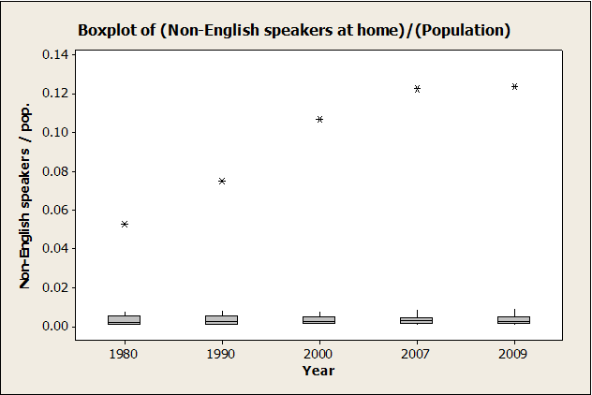
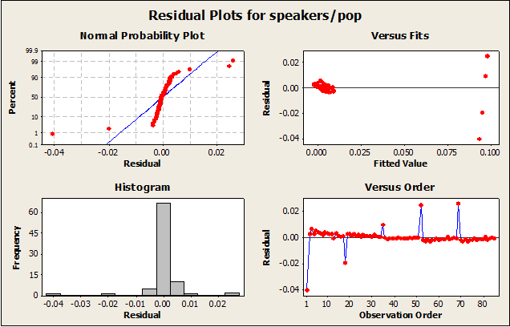
First Analysis: Results
Two-way ANOVA
  Fyear = 1.18
  P-val. = 0.328
:. Fail to reject H0 at the α = 0.05 level
Friedman Test
  S = 3.76
  P-val = 0.439
:. Fail to reject H0 at the α = 0.05 level

Slide 5
First Analysis: Results
Page’s Procedure
  L = 801
  L* = 1.74626
  P-val. = 0.04038
:. reject H0 at the α = 0.05 level

Slide 6
Second Analysis: Post-Secondary language enrollment in the U.S
Parametric
  Pearson’s Test
H₀: There is no linear association between year and the proportion of students enrolled in post-secondary language courses over the 18-24 year old population.
H_{a}: There is a linear association between year and the proportion of students enrolled in post-secondary language courses over the 18-24 year old population.
Nonparametric
  Spearman’s Test
H₀: There is no association between year and the proportion of students enrolled in post-secondary language courses over the 18-24 year old population.
H_{a}: There is an association between year and the proportion of students enrolled in post-secondary language courses over the 18-24 year old population.

Slide 7
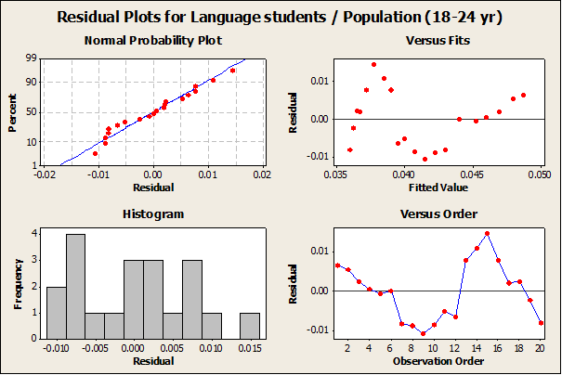
Second Analysis: Results
Pearson
  P-val. = 0.02711
:. Reject H0
Sample Estimate
  cor = 0.493237
:. Suggests Positive
Association
Spearman
  P-val. = 0.08164
:. Fail to reject H0

Slide 8
Second Analysis: Part II
Same Procedure as Part I, but now testing individual languages
Two methods of modeling interest in a language
    Post-Secondary Students Enrolled among 18-24 year-old Population
    Proportion of Total Post-Secondary Language Students enrolled in the Specified Language

Slide 9
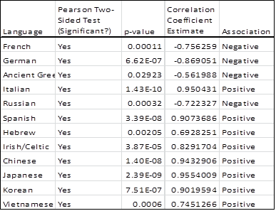
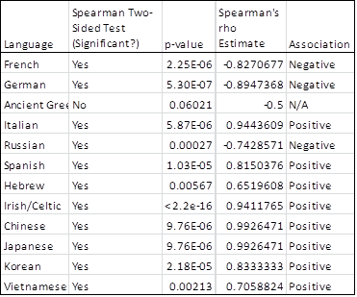
Independence between Years & Post-Secondary Language Enrollment over 18-24 Year-Old U.S. Population

Slide 10
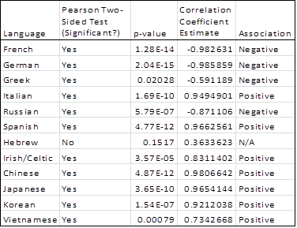
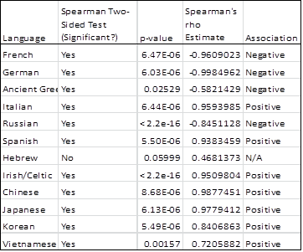
Independence between Years & Proportion of Post-Secondary Language Students Enrolled in a Particular Language

Slide 11
Third Analysis: Post-Secondary students enrolled in Spanish.
Six Regions
  Midwest, Northeast, Pacific Coast, Rocky Mountain, South Atlantic, & South Central
  2 Tests Preformed on each region
Parametric
  2-way ANOVA F-test
H₀: The mean proportion of U.S. 18-24 year olds enrolled in Spanish does not depend on year.
H_{a}: Year does have an effect on the mean proportion of U.S. 18-24 year olds enrolled in Spanish.
Nonparametric
  Friedman Test
H₀: The median proportion of U.S. 18-24 year olds enrolled in Spanish does not depend on year.
H_{a}: Year does have an effect on the median proportion of U.S. 18-24 year olds enrolled in Spanish.
Response = Proportion enrolled in Spanish
Treatment = Year
Blocks = State

Slide 12
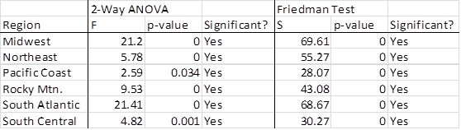
Third Analysis: Results

Slide 13
What to make of it all?
And possibilities for further analyses

Slide 14
Data Sources
Institute for Education Statistics. (2010, September 10). Youth Indicators 2011: America’s Youth: Transitions to Adulthood. Retrieved December 2012, from National Center for Education Statistics: http://nces.ed.gov/pubs2012/2012026/tables/table_01.asp
Modern Language Association. (2012, December 15). Language Map with Enrollment Data. Retrieved December 2012, from Modern Language Association: http://arcgis.mla.org/mla/default.aspx
Shin, H. B., & Kominski, R. A. (2010, April). Language Use in the United States: 2007. Retrieved December 2012, from U.S. Census Bureau: http://www.census.gov/hhes/socdemo/language/data/acs/ACS-12.pdf
U.S. Census Bureau. (2011-2012). Population Estimates: Historical Data. Retrieved December 2012, from U.S. Census Bureau: http://www.census.gov/popest/data/historical/index.html

